Slide 1

Frank Sarfo
Lokesh
Rafael Dias Rocha

Slide 2
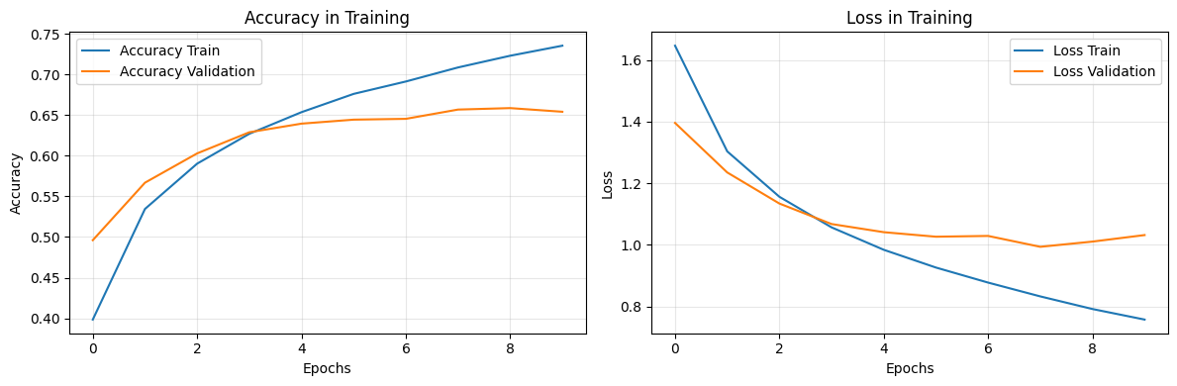
Basic CNN - Architecture & Performance
Initial Approach & Findings:
We developed a custom CNN with three convolutional layers of increasing filter complexity (32→64→64).
The model achieved strong training accuracy (78.2%), but showed clear signs of overfitting, with validation performance dropping to 68.6%.
This 9.6% generalization gap indicates the model was memorizing training data patterns rather than learning robust, transferable features.

Slide 3
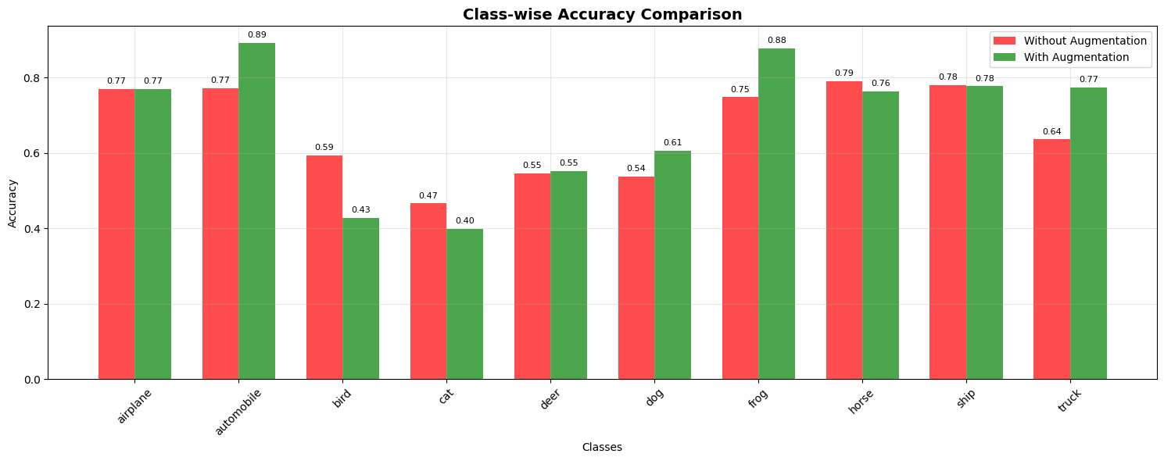
CNN WITH DATA AUGMENTATION
Enhanced Methodology & Results:
To combat overfitting, we implemented a comprehensive regularization strategy including data augmentation (rotations, shifts, flips), batch normalization, and progressive dropout (25-50%).
This approach yielded remarkable improvements: test accuracy increased to 76.8% (+8.2% improvement).
The model demonstrated significantly better generalization across all classes.

Slide 4
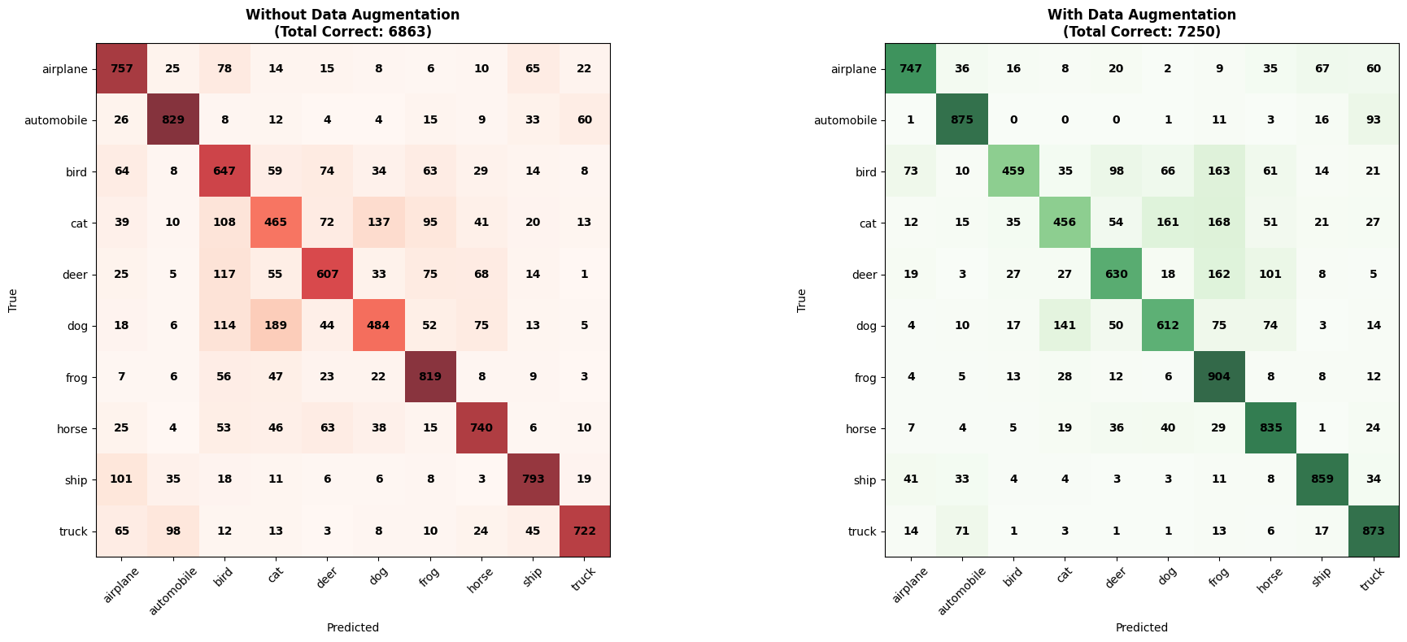
COMPARISON: WITH vs WITHOUT AUGMENTATION
Comparative Performance Analysis:
Our systematic evaluation revealed substantial improvements across all metrics.
The CNN with data augmentation achieved 76.8% test accuracy compared to 68.6% without augmentation - an 8.2% improvement.
This significant gain demonstrates data data augmentation effectiveness in enhancing model generalization and reducing overfitting, leading to more robust feature learning.

Slide 5
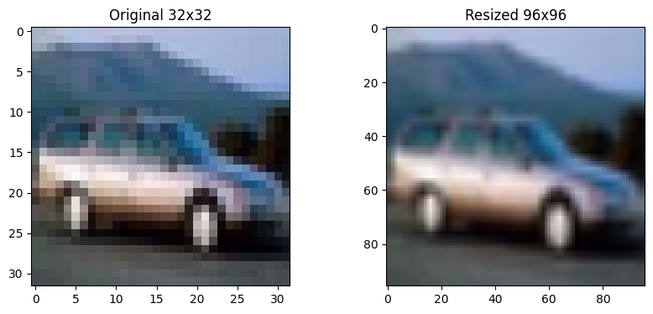
TRANSFER LEARNING WITH MOBILENETV2
Advanced Strategy Implementation:
We leveraged MobileNetV2 pre-trained on ImageNet, employing a sophisticated two-phase training approach.
A critical preprocessing step involved resizing images from 32×32 to 96×96 pixels, ensuring compatibility with MobileNetV2's architecture while preserving essential visual information.
The base network was initially frozen while custom classification layers were trained, followed by careful fine-tuning of the final 50 layers.
This strategy capitalized on established feature extraction capabilities while adapting the model to our specific CIFAR-10 classification task, significantly reducing training time and computational requirements.

Slide 6
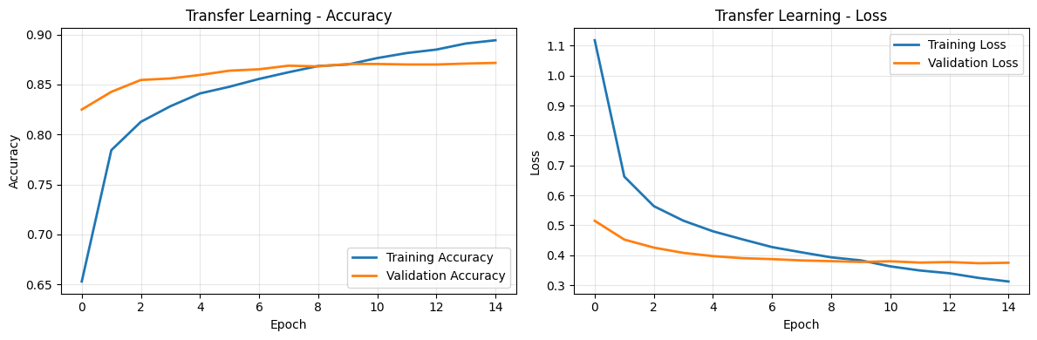
TRANSFER LEARNING RESULTS
Performance Breakthrough:
The transfer learning approach achieved exceptional results with 91.23% test accuracy - a 32.9% improvement over our baseline CNN and 18.8% improvement over the augmented model.
The model demonstrated outstanding performance on distinct categories like ships (95%+) and airplanes (93%+), while maintaining consistent accuracy across all classes with minimal overfitting and stable convergence.

Slide 7
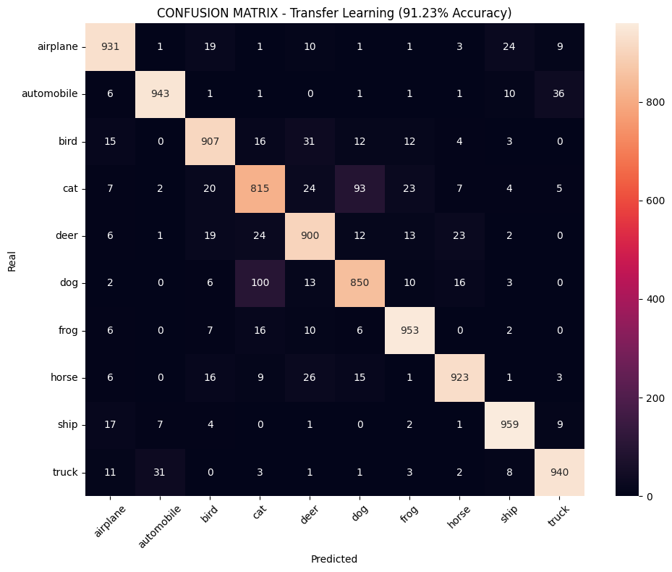
DETAILED TL ANALYSIS
Comprehensive Performance Assessment:
Despite the outstanding 91.23% overall accuracy, our analysis reveals persistent challenges in distinguishing semantically similar categories.
Cat classification remained the most challenging at approximately 86%, with common confusions occurring between cats/dogs and birds/airplanes.
However, transfer learning conclusively proved superior, delivering the optimal balance between performance (91.23%), training efficiency, and generalization capability while leveraging pre-existing feature knowledge.

Slide 8
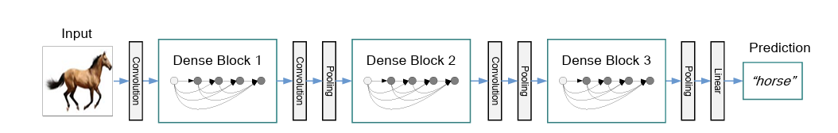
DenseNet 121
Dense connectivity boosts feature reuse.
Low parameter count, high efficiency.
Strong accuracy for image classification tasks.
Model | Model Size(Mb) | Top 1 acc(%) | Top 5 acc(%) | Parameters(M) | Depth
DenseNet121 | 33 | 74.91% | 92.38% | 8.0 | 121

Slide 9
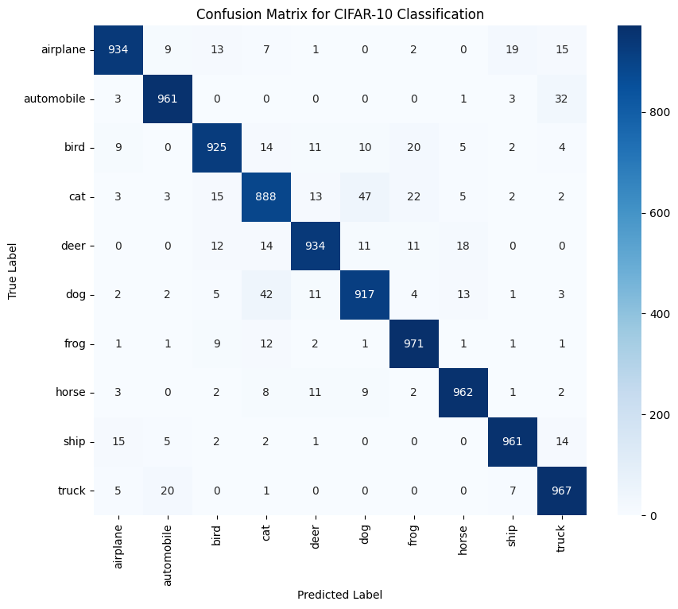
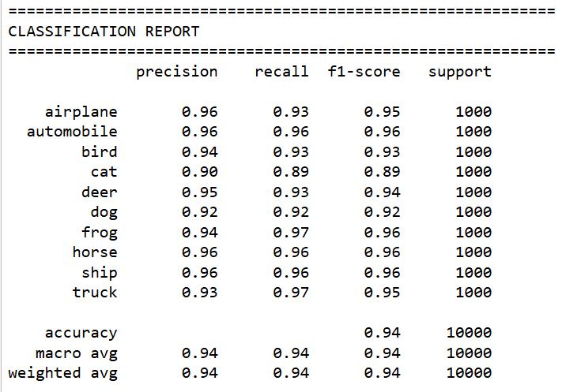

Slide 10
DenseNet 121
Model | Train acc(%) | Valid acc(%) | Test acc(%) | Train Loss | Valid Loss
DenseNet121 (base Model) | 32% | 35% |  | 1.81 | 1.78
DenseNet121 (Fine Tuning) | 98% | 94.2% | 94.2% | 0.06 | 0.21
Fine Tuning:
Data augmentation(Rotation, Translation, Zooming, Flipping)
Freezing Layers(First Layers, Last Layers)
Classification head
Callbacks

Slide 11
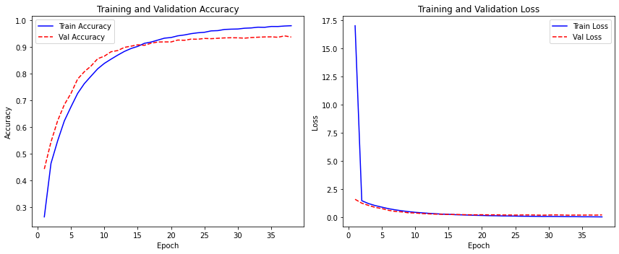
Densenet 121 Plots
Accuracy improves rapidly and plateaus above 93%.
Training and validation loss steadily decrease and stay close.
No signs of overfitting; model generalizes well to unseen data.

Slide 12
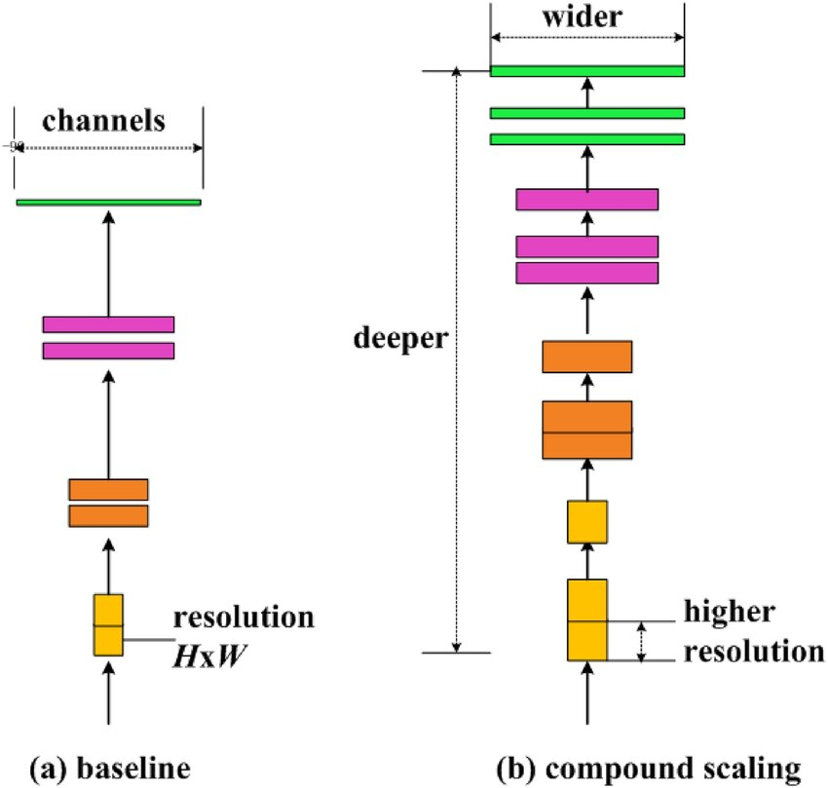

EfficientNet_V2_B0
High accuracy, low compute.
Compound scaling: depth, width, resolution.
Small models, fast inference.
Model | Model Size(Mb) | Top 1 acc(%) | Top 5 acc(%) | Parameters(M) | Depth
EfficientNetV2B0 | 28 | 78.7% | 94.3% | 7.2

Slide 13
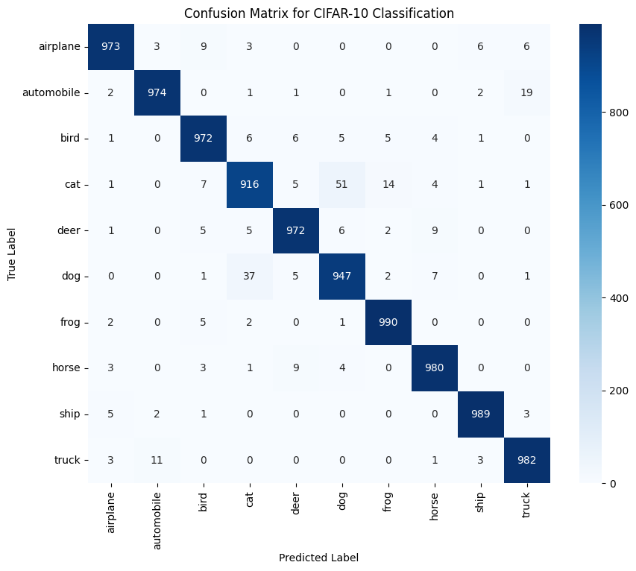
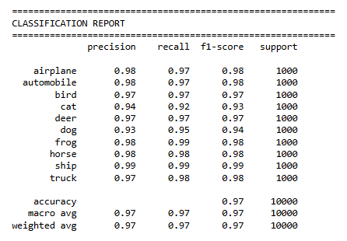

Slide 14
EfficientNetV2_B0 Plots
Model | Train acc(%) | Valid acc(%) | Test acc(%) | Train Loss | Valid Loss
EfficientNetV2_bo (base Model) | 48% | 42% |  | 1.2 | 1.46
EfficientNetV2_bo (Fine Tuning) | 98% | 97% | 97% | 0.057 | 0.096
Fine Tuning:
Data augmentation(Rotation, Translation, Zooming, Flipping)
Freezing Layers(First Layers, Last Layers)
Classification head
32*32*3—---------> 164*164*3
Callbacks
Learning Rate control

Slide 15
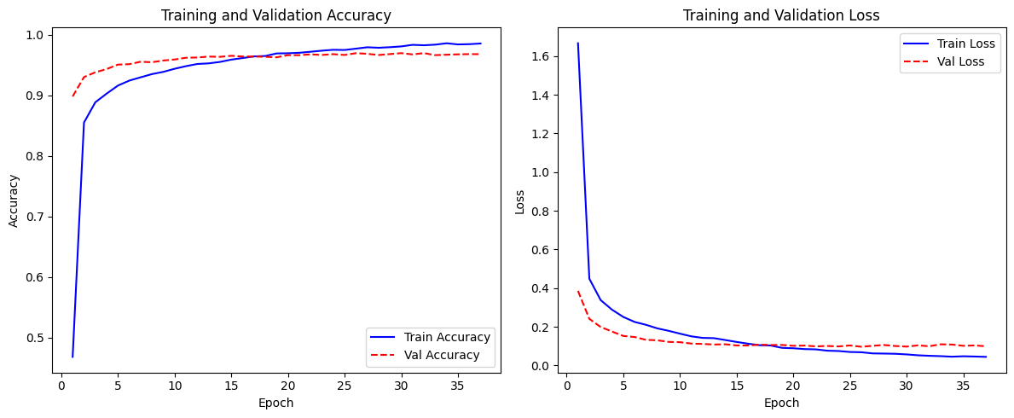
EfficientNetV2_B0 Plots
Accuracy improves rapidly and exceeds 95% for both train and validation sets.
Loss values decrease and remain closely matched, indicating stable and effective learning.
No sign of overfitting, as training and validation curves track closely throughout.

Slide 16
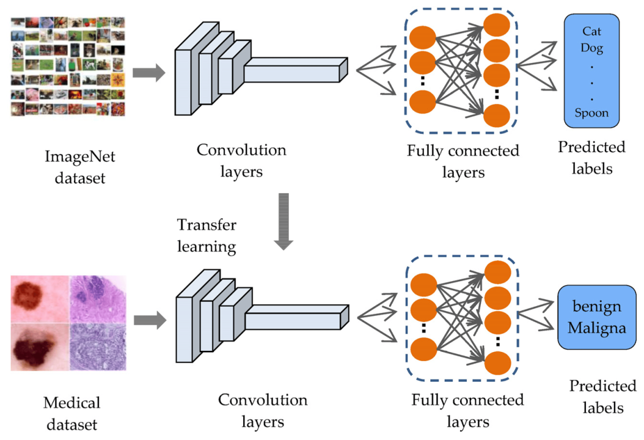
EfficientNetB0 Architecture Overview
Pretrained on ImageNet → strong feature extractor
Convolution layers reused for CIFAR-10 images
Custom dense layers added for 10-class classification
Fine-tuned top layers for improved accuracy & generalization

Slide 17
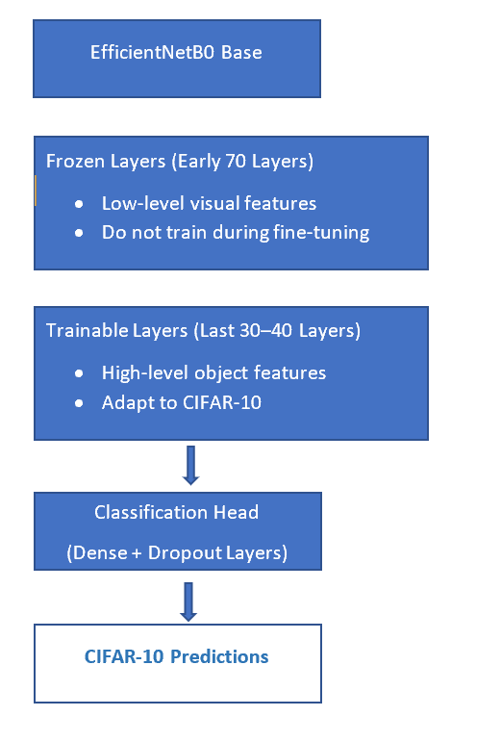
Selective Fine-Tuning Strategy (EfficientNetB0)
Phase 1: Train classification head only
Phase 2: Unfreeze the last 30–40 layers
Freeze first 70+ layers for stable transfer learning
Use low learning rate (1e-5) to avoid damaging pretrained weights
Benefits: Prevents catastrophic forgetting & improves class-specific learning

Slide 18
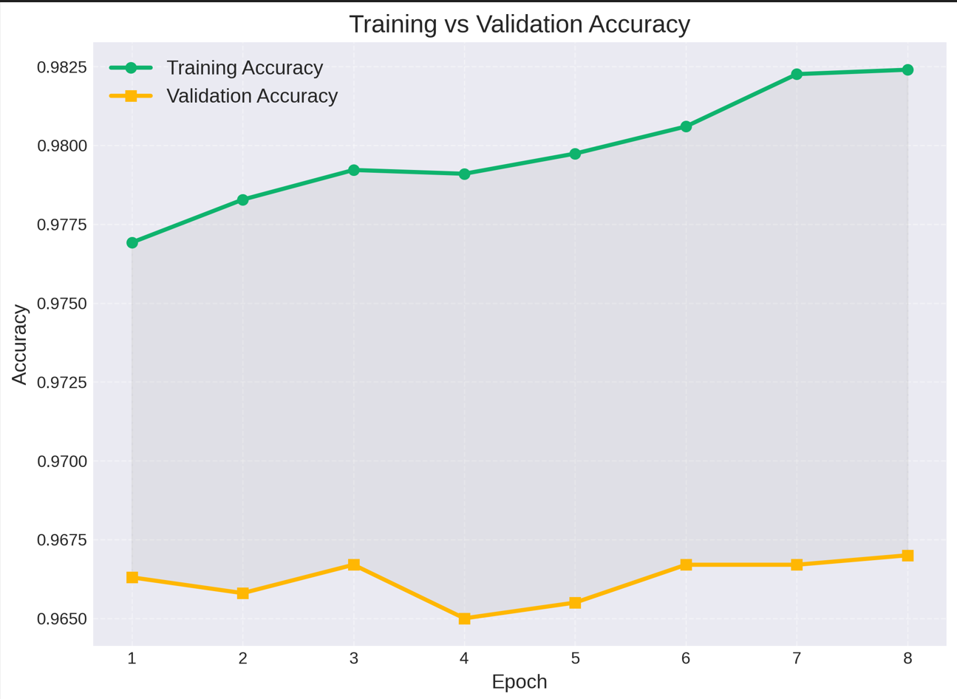
Training Progress: Accuracy
The training accuracy curve shows steady improvements
The validation accuracy curve follows a similar trend
A small gap between training and validation accuracy indicates minimal overfitting
Fine-tuning phase gives the biggest jump

Slide 19
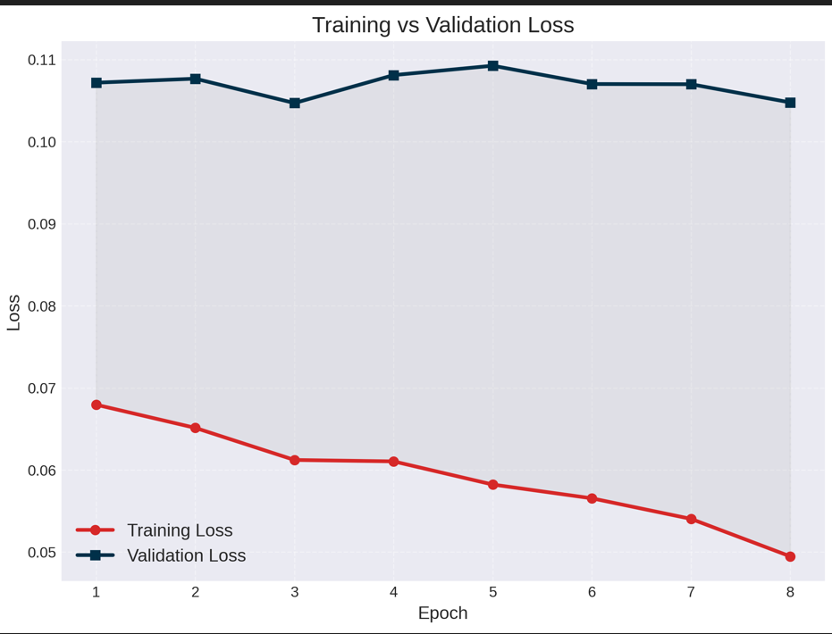
Training vs Validation Loss
Sharp fall in loss during early epochs
Validation loss consistently decreasing
No oscillation → stable training
Dropout + batch normalization preventing overfitting

Slide 20

Final Model Evaluation
The matrix shows high precision and recall across all classes, with only minor confusion occurring between visually similar objects (e.g., cat/dog, truck/automobile).

Slide 21
Model Comparison
Model | Train acc(%) | Valid acc(%) | Test acc(%) | Train Loss | Valid Loss
CNN | 78.2% | 68.6% | 68.6% | 0.62 | 0.997
CNN Aug. | 71.0% | 76.1% | 76.8% | 0.84 | 0.691
MobileNetV2 | 95.7% | 91.2% | 91.2% | 0.13 | 0.267
EfficientNetB0 | 98.3% | 96.7% | 96.7% | 0.04 | 0.1
DenseNet121 | 98% | 94.2% | 94% | 0.06 | 0.021
EfficientNetv2B0 | 98% | 97% | 97% | 0.057 | 0.096

Slide 22
Transfer Learning vs. Scratch
Feature | Transfer Learning (TL) | Building From Scratch
Data Requirement | Low (Small to medium dataset) | High (Requires massive dataset, often millions)
Training Time | Very Fast (Only fine-tuning the last layers) | Very Slow (Training all layers from scratch)
Computational Cost | Low (Primarily inference and fine-tuning) | Very High (Requires extensive GPU/TPU time)
Initial Performance | High Baseline (Leverages pre-trained knowledge) | Low (Starts randomly, depends entirely on your data)
Customization | Low (Constrained by the base architecture) | High (Full control over every layer)
Best For | Common tasks, small/medium data, quick deployment | Novel problems, highly unique domains, unlimited resources

Slide 23
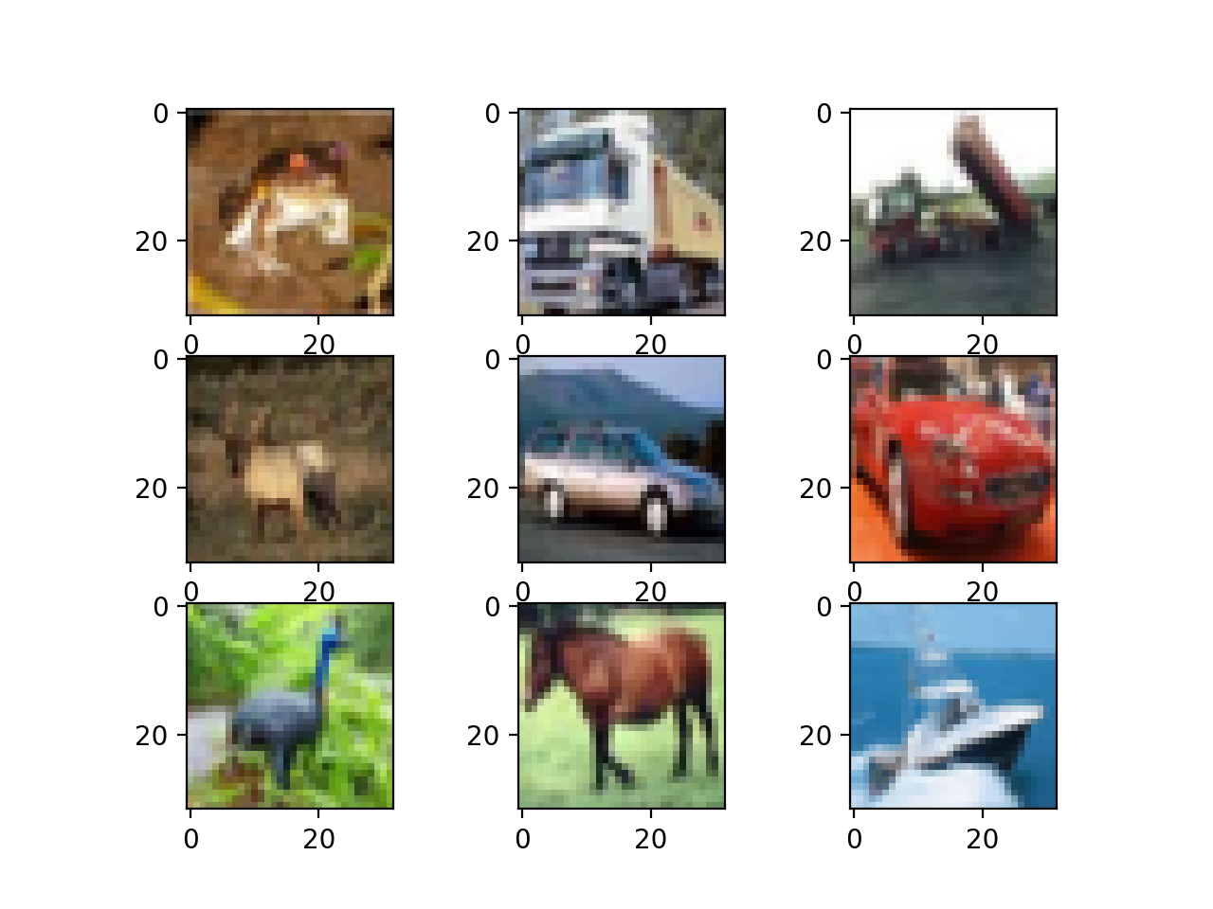
Conclusion
The transfer learning models, particularly EfficientNetv2B0 and EfficientNetB0, are the most powerful, high-accuracy, production-ready image classifiers, significantly outperforming the custom CNN and the MobileNetV2 model.
EfficientNetv2B0 achieved the highest test accuracy (97%), narrowly exceeding EfficientNetB0's 96.7% and DenseNet121's 94%.

